Slide 1
Head Injury Terminology and Identification
Sports Medicine

Slide 2
Bellwork
Think of a time when you or someone you knew had a head injury? If it has never happened, think of a time when you saw a head injury on TV or in a movie?
What happened and what did you feel when this head injury happened?
Be ready to share any symptoms that you remember from that injury?
Do you remember the treatment or recovery of that injury?

Slide 3
Today’s Objectives
Student will be able to:
1. Define terminology
2. Identify a head injury
3. Assess a head injury
4. Treat a head injury
5. Videos of head injury scenarios
6. Discuss Current Events

Slide 4
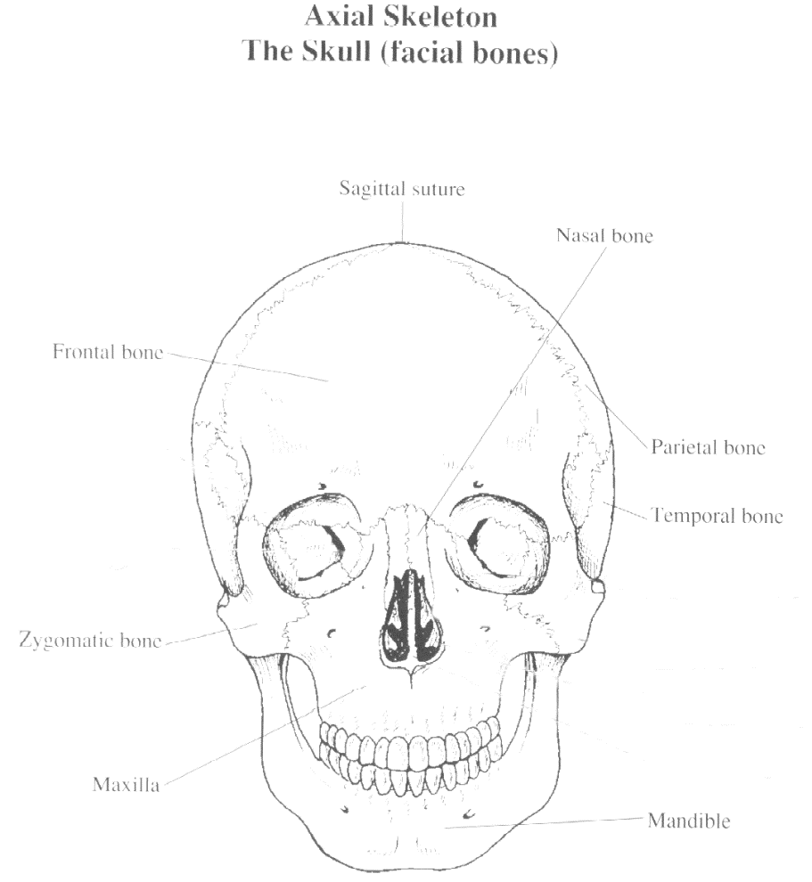
Introduction: Head Injuries are the most common cause of catastrophic sports injuries. Sports with the highest incidence of head injuries are;
  Football
  Boxing
  Ice hockey

Slide 5
Graphic Organizer
On the following slides please fill in the vocab words as they are explained

Slide 6
Terminology
  ____________________- characterized by immediate and temporary impairment of neural function such as alteration of consciousness, disturbance of vision or equilibrium caused by mechanical forces.
Traumatic Brain Injury
Leading cause of athletic death
Most frequent type of head injury in sports
20% of high school football payers sustain a concussion over a single season
National Football Head/Neck Injury Registry, Talley of the FB injuries annually
Avg. per yr: 250,000 concussions
8 deaths
7 quads
45 cervical fractures

Slide 7
  _______________ - implies “bruising” of the brain, involves bleeding of the brain tissue
  ____________________– is bleeding or pooling of blood between the tissue layers covering the brain or inside the brain
  ___________– a crack or break in the skull
  _____________– occurring on the opposite side. An injury to the brain located on the side opposite that of the primary injury.
Cerebral Contusion
Hemorrhage
Fracture
Contracoup

Slide 8
Cerebrospinal
  _________________– fluid which completely surround and suspends the brain. The main function is cushioning, to diminish the transmission of shocking forces
  _________– ringing in the ears
  _________ – dancing eyes
Tinnitus
Nystagmus

Slide 9
Anterograde Amnesia
  _________________ – unable to recall events occurring immediately after trauma
  _________________ – unable to recall events occurring immediately before trauma
  _________________– a test for balance and coordination. Stand with feet together and head tilted back.
    Positive test = swaying
  __________ – pupils equal and reactive to light
Retrograde Amnesia
Rhomberg’s Test
PEARL

Slide 10
  ________________________– “knocked out”
  ________________________– unable to recall events that have occurred since the time of injury
  _____________– (No Signs or Symptoms) no headache, no dizziness, no impaired orientation, concentration, or memory, during rest or execration
  _______________________– reflects alter neurotransmitter function, rapid processing and recall of new information is the most impaired function
Loss of Consciousness (LOC)
Post Traumatic Amnesia
Asymptomatic
Post Concussion Syndrome

Slide 11
  _____________________ – acute, usually fatal, brain swelling that occurs when a second concussion is sustained before complete recovery from a previous concussion.
    Causes vascular congestion and increased intracranial pressure which may be difficult or impossible to control
    Effects of head trauma are cumulative
    Chance of second impact is 4X greater
Second Impact Syndrome

Slide 12
Arrival Assessment
What you should observe as you are approaching the downed athlete
  Are they moving? Limbs? Eyes?
  Body position?
    Rigidity?
    Prone? Supine? Neck angle?
  Level of consciousness:
    Unconscious and not breathing
    Unconscious and breathing
    Conscious
Notes:
Decerebrate- straight as a board
Decorticate- arms are curled up
Prone- lay on belly
Supine- lay on back
Neck angle- 30 degrees of flexion, loss of angle in neck

Slide 13
On Field Assessment
When you get to the athlete:
  One immediately stabilizes the head, while another performs the evaluation
  Check ABC’s- begin CPR? AED?
  Determine level of consciousness (LOC)
    If unconsc and not breathing- begin CPR/ AED
    If unconsc and breathing- treat as if a neck fx
    If consc- continue with eval
  Check ears and nose- presence of CSF
  Quick body visual for gross deformities and/ or bleeding
  Check vitals- respiration, pulse, blood pressure, pupils

Slide 14
On Field Assessment
If they’re conscious and moving their limbs as you are approaching, should you still immediately stabilize the head and neck?
If they’re conscious and you stabilize the head and neck, how long should you continue to stabilize?
If they are unconscious ALWAYS treat like a cervical fracture with head trauma

Slide 15

A-B Partner Teach
Partner A turn to partner B.
Explain to your partner what the arrival assessment and the
on-field assessment you have learned so far…
Switch roles and repeat the process.
15
PROPERTY OF PIMA COUNTY JTED, 2010
Notes:
20. A-B Partner Teach
partner A turn to partner B
tell or teach your partner the two most important things you have
learned so far about...
switch roles and repeat the process
teacher calls on non-volunteers

Slide 16

Pass…
PLAY!
OR
Head Injury Terminology and Identification
PROPERTY OF PIMA COUNTY JTED, 2010
PROPERTY OF PIMA COUNTY JTED, 2010
Notes:
5. Pass or Play
teacher poses a question and gives wait time
teacher calls on a student and asks them “pass or play?”
student says “play” if they wish to answer the question or “pass to__________” if they want to pass to a specific classmate
teacher provides feedback

